Slide 1


Object-Oriented Programming
© 2013 Goodrich, Tamassia, Goldwasser
Object-Oriented Programming

Slide 2
Terminology
Each object created in a program is an instance of a class.
Each class presents to the outside world a concise and consistent view of the objects that are instances of this class, without going into too much unnecessary detail or giving others access to the inner workings of the objects.
The class definition typically specifies instance variables, also known as data members, that the object contains, as well as the methods, also known as member functions, that the object can execute.
© 2013 Goodrich, Tamassia, Goldwasser
Object-Oriented Programming

Slide 3
Goals
Robustness
  We want software to be capable of handling unexpected inputs that are not explicitly defined for its application.
Adaptability
  Software needs to be able to evolve over time in response to changing conditions in its environment.
Reusability
  The same code should be usable as a component of different systems in various applications.
© 2013 Goodrich, Tamassia, Goldwasser
Object-Oriented Programming

Slide 4
Abstract Data Types
Abstraction is to distill a system to its most fundamental parts.
Applying the abstraction paradigm to the design of data structures gives rise to abstract data types (ADTs).
An ADT is a model of a data structure that specifies the type of data stored, the operations supported on them, and the types of parameters of the operations.
An ADT specifies what each operation does, but not how it does it.
The collective set of behaviors supported by an ADT is its public interface.
© 2013 Goodrich, Tamassia, Goldwasser
Object-Oriented Programming

Slide 5
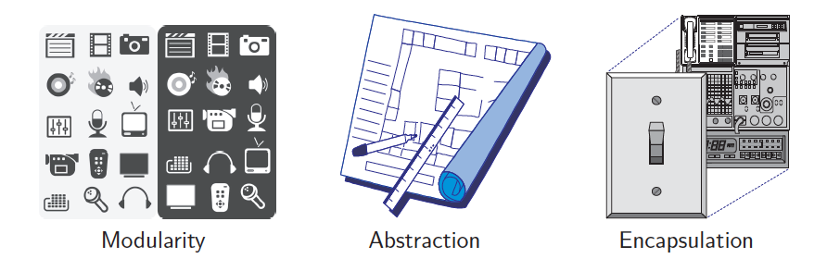
Object-Oriented Design Principles
Modularity
Abstraction
Encapsulation
© 2013 Goodrich, Tamassia, Goldwasser
Object-Oriented Programming

Slide 6

Duck Typing
Python treats abstractions implicitly using a mechanism known as duck typing.
  A program can treat objects as having certain functionality and they will behave correctly provided those objects provide this expected functionality.
As an interpreted and dynamically typed language, there is no “compile time” checking of data types in Python, and no formal requirement for declarations of abstract base classes.
The term “duck typing” comes from an adage attributed to poet James Whitcomb Riley, stating that “when I see a bird that walks like a duck and swims like a duck and quacks like a duck, I call that bird a duck.”
© 2013 Goodrich, Tamassia, Goldwasser
Object-Oriented Programming

Slide 7
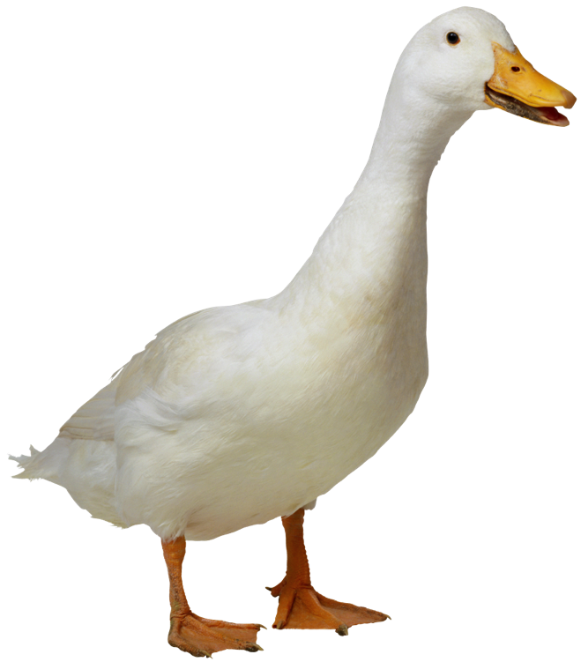
Abstract Base Classes
Python supports abstract data types using a mechanism known as an abstract base class (ABC).
An abstract base class cannot be instantiated, but it defines one or more common methods that all implementations of the abstraction must have.
An ABC is realized by one or more concrete classes that inherit from the abstract base class while providing implementations for those method declared by the ABC.
We can make use of several existing abstract base classes coming from Python’s collections module, which includes definitions for several common data structure ADTs, and concrete implementations of some of these.
© 2013 Goodrich, Tamassia, Goldwasser
Object-Oriented Programming

Slide 8
Encapsulation
Another important principle of object-oriented design is encapsulation.
  Different components of a software system should not reveal the internal details of their respective implementations.
Some aspects of a data structure are assumed to be public and some others are intended to be internal details.
Python provides only loose support for encapsulation.
  By convention, names of members of a class (both data members and member functions) that start with a single underscore character (e.g., _secret) are assumed to be nonpublic and should not be relied upon.
© 2013 Goodrich, Tamassia, Goldwasser
Object-Oriented Programming

Slide 9

Design Patterns
Algorithmic patterns:
Recursion
Amortization
Divide-and-conquer
Prune-and-search
Brute force
Dynamic programming
The greedy method
Software design patterns:
Iterator
Adapter
Position
Composition
Template method
Locator
Factory method
© 2013 Goodrich, Tamassia, Goldwasser
Object-Oriented Programming

Slide 10
Object-Oriented
Software Design
Responsibilities: Divide the work into different actors, each with a different responsibility.
Independence: Define the work for each class to be as independent from other classes as possible.
Behaviors: Define the behaviors for each class carefully and precisely, so that the consequences of each action performed by a class will be well understood by other classes that interact with it.
© 2013 Goodrich, Tamassia, Goldwasser
Object-Oriented Programming

Slide 11
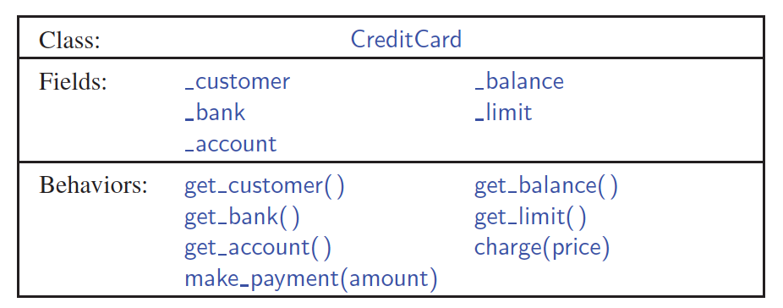
Unified Modeling Language (UML)
A class diagram has three portions.
The name of the class
The recommended instance variables
The recommended methods of the class.
© 2013 Goodrich, Tamassia, Goldwasser
Object-Oriented Programming

Slide 12
Class Definitions
A class serves as the primary means for abstraction in object-oriented programming.
In Python, every piece of data is represented as an instance of some class.
A class provides a set of behaviors in the form of member functions (also known as methods), with implementations that belong to all its instances.
A class also serves as a blueprint for its instances, effectively determining the way that state information for each instance is represented in the form of attributes (also known as fields, instance variables, or data members).
© 2013 Goodrich, Tamassia, Goldwasser
Object-Oriented Programming

Slide 13
The self Identifier
In Python, the self identifier plays a key role.
In any class, there can possibly be many different instances, and each must maintain its own instance variables.
Therefore, each instance stores its own instance variables to reflect its current state. Syntactically, self identifies the instance upon which a method is invoked.
© 2013 Goodrich, Tamassia, Goldwasser
Object-Oriented Programming

Slide 14
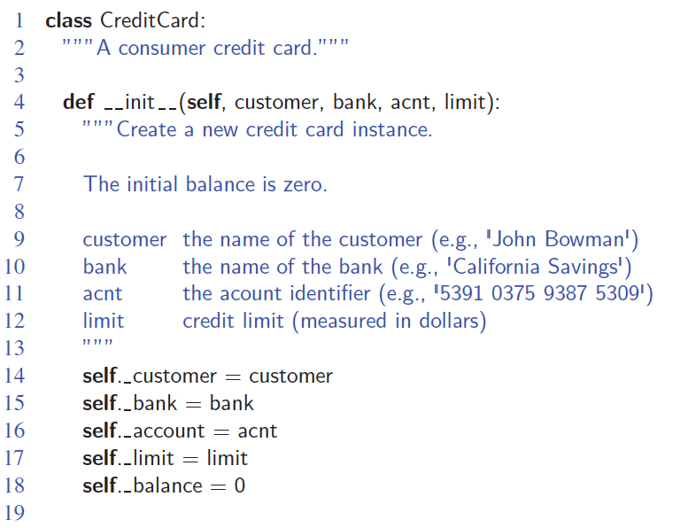
Example
© 2013 Goodrich, Tamassia, Goldwasser
Object-Oriented Programming

Slide 15
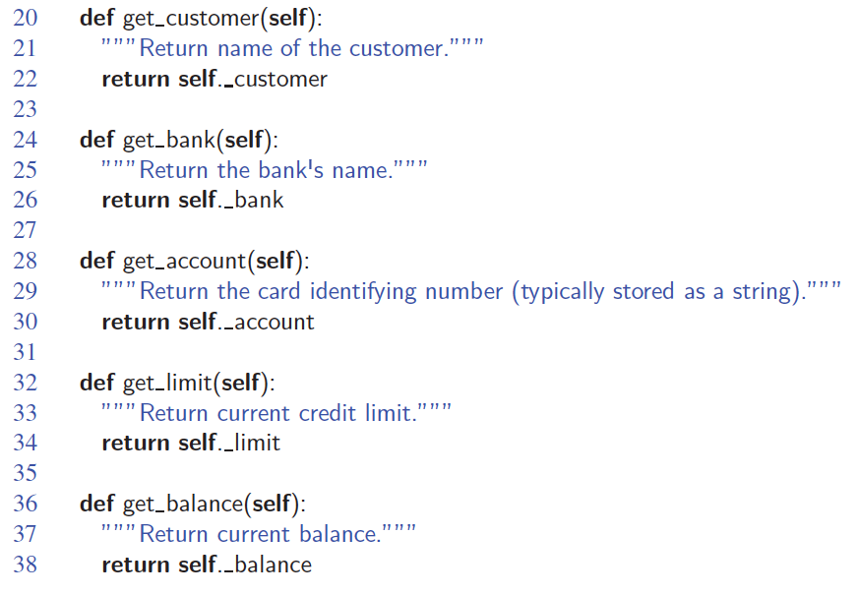
Example, Part 2
© 2013 Goodrich, Tamassia, Goldwasser
Object-Oriented Programming

Slide 16
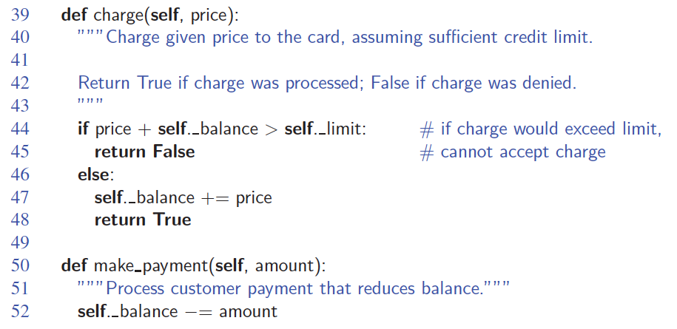
Example, Part 3
© 2013 Goodrich, Tamassia, Goldwasser
Object-Oriented Programming

Slide 17
Constructors
A user can create an instance of the CreditCard class using a syntax as:
Internally, this results in a call to the specially named __init__ method that serves as the constructor of the class.
Its primary responsibility is to establish the state of a newly created credit card object with appropriate instance variables.
© 2013 Goodrich, Tamassia, Goldwasser
Object-Oriented Programming

Slide 18
Operator Overloading
Python’s built-in classes provide natural semantics for many operators.
For example, the syntax a + b invokes addition for numeric types, yet concatenation for sequence types.
When defining a new class, we must consider whether a syntax like a + b should be defined when a or b is an instance of that class.
© 2013 Goodrich, Tamassia, Goldwasser
Object-Oriented Programming

Slide 19
Iterators
Iteration is an important concept in the design of data structures.
An iterator for a collection provides one key behavior:
  It supports a special method named __next__ that returns the next element of the collection, if any, or raises a StopIteration exception to indicate that there are no further elements.
© 2013 Goodrich, Tamassia, Goldwasser
Object-Oriented Programming

Slide 20
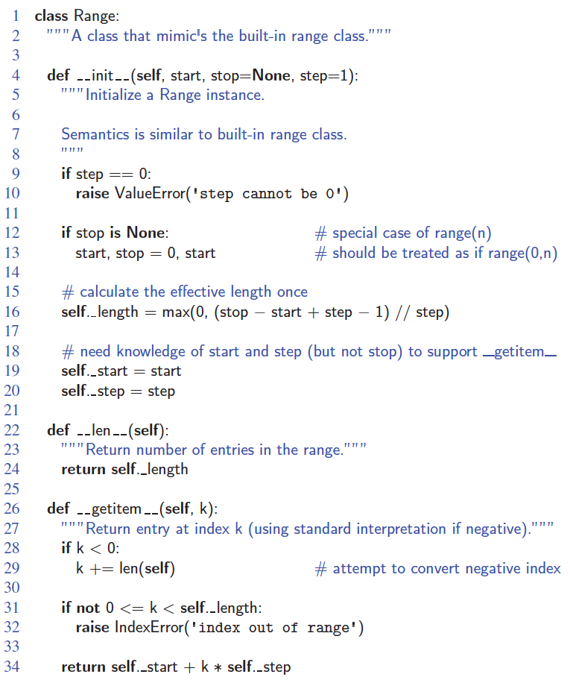
Automatic Iterators
Python also helps by providing an automatic iterator implementation for any class that defines both __len__ and __getitem__.
© 2013 Goodrich, Tamassia, Goldwasser
Object-Oriented Programming

Slide 21
Inheritance
A mechanism for a modular and hierarchical organization is inheritance.
This allows a new class to be defined based upon an existing class as the starting point.
The existing class is typically described as the base class, parent class, or superclass, while the newly defined class is known as the subclass or child class.
There are two ways in which a subclass can differentiate itself from its superclass:
  A subclass may specialize an existing behavior by providing a new implementation that overrides an existing method.
  A subclass may also extend its superclass by providing brand new methods.
© 2013 Goodrich, Tamassia, Goldwasser
Object-Oriented Programming

Slide 22
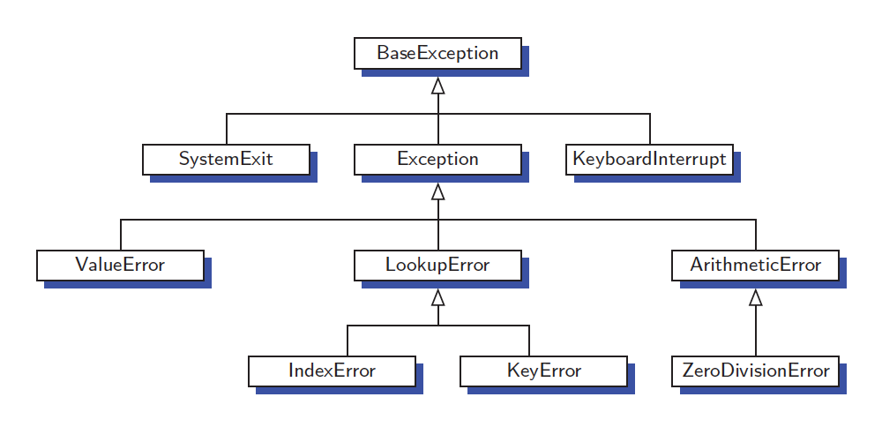
Inheritance is Built into Python
A portion of Python’s hierarchy of exception types:
© 2013 Goodrich, Tamassia, Goldwasser
Object-Oriented Programming

Slide 23
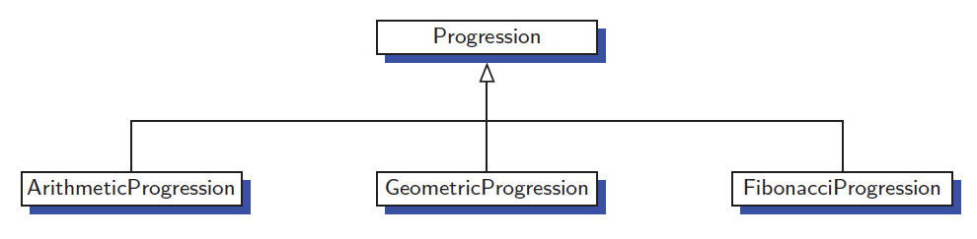
An Extended Example
A numeric progression is a sequence of numbers, where each number depends on one or more of the previous numbers.
  An arithmetic progression determines the next number by adding a fixed constant to the previous value.
  A geometric progression determines the next number by multiplying the previous value by a fixed constant.
  A Fibonacci progression uses the formula N_{i+1}=N_{i}+N_{i-1}
© 2013 Goodrich, Tamassia, Goldwasser
Object-Oriented Programming

Slide 24
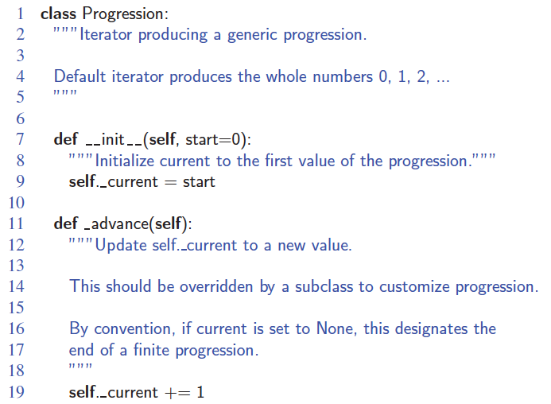
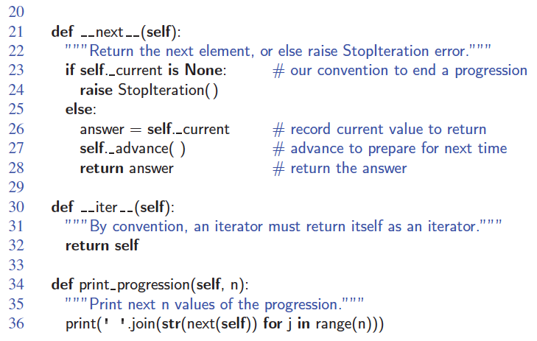
The Progression Base Class
© 2013 Goodrich, Tamassia, Goldwasser
Object-Oriented Programming

Slide 25
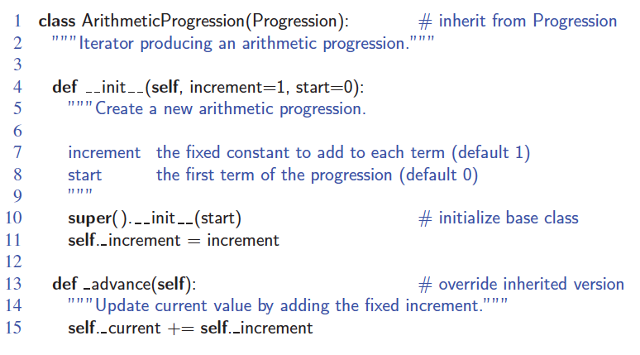
ArithmeticProgression Subclass
© 2013 Goodrich, Tamassia, Goldwasser
Object-Oriented Programming

Slide 26
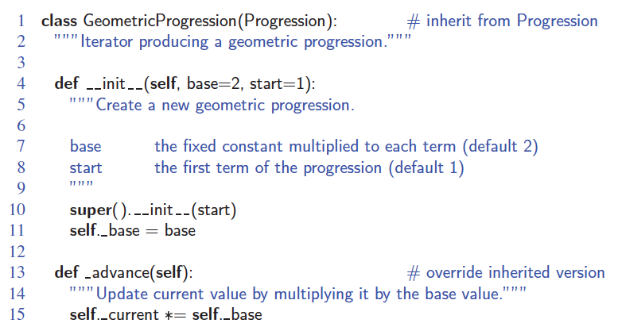
GeometricProgression Subclass
© 2013 Goodrich, Tamassia, Goldwasser
Object-Oriented Programming

Slide 27
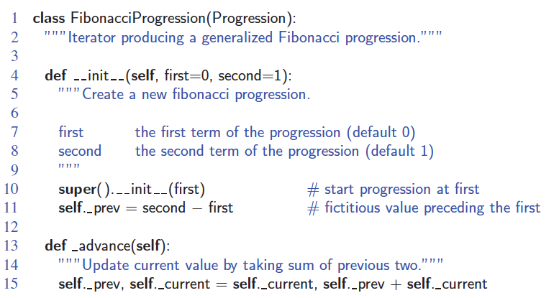
FibonacciProgression Subclass
© 2013 Goodrich, Tamassia, Goldwasser
Object-Oriented Programming

